Slide 1
SAAAD DSGT Project Presentation
Silas Ropp, Andrew DiBiasio, Daeyong Kwon
Notes:
Daeyong

Slide 2
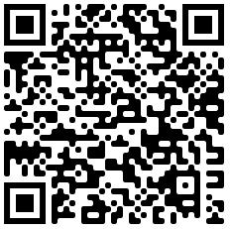
Explored Dataset
Age, Gender, and Ethnicity CSV on Kaggle
23705 entries
Age
Actual Numeric Value of Age
Ethnicity
0 - White
1 - Black
2 - Asian
3 - Indian
4 - Hispanic
Gender
0 - Male
1 - Female
Image Name
x.jpg
Pixels
48 * 48 grayscale matrix
Notes:
Andrew:
A dataset containing 23705 face images and data on their age, gender, and ethnicity
Some of the

Slide 3




Motivating Factors
Face ID
Airports
Computer Vision
Facial Recognition Systems
Notes:
Silas
Mention
Companies like Apple are using features like Face ID for security
High-security facilities like Airports are using facial detection to identify individuals for international travel
Countries like China are implementing facial recognition systems, integrating them into the public
Any form of research into the Computer Vision field requires Data Science to be used in conjunction with Images

Slide 4
Stage 1
Exploring Data
Notes:
Daeyong

Slide 5
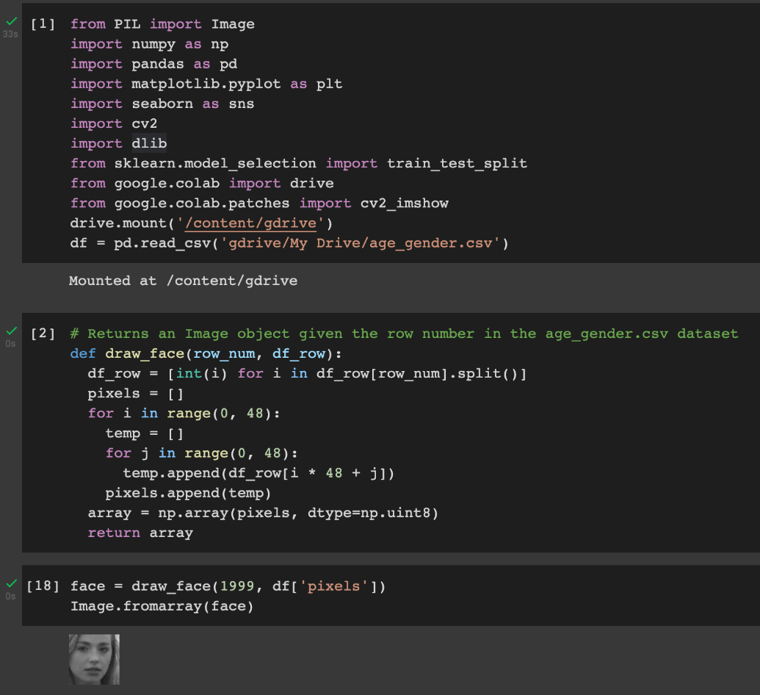
Libraries and Reconstructing Faces
Notes:
Daeyong
Mention:
Imported various libraries used for exploratory data analysis + future machine learning
Had to integrate Google Drive into the Google Collab to test our model using custom images, which we’ll demonstrate later
Since the Kaggle dataset didn’t provide real faces, we decided to see what they actually look like by reconstructing it with the code in the second cell.
The third cell is an auxiliary cell to show what the grayscale faces look like, but is not included in the final code delivery

Slide 6
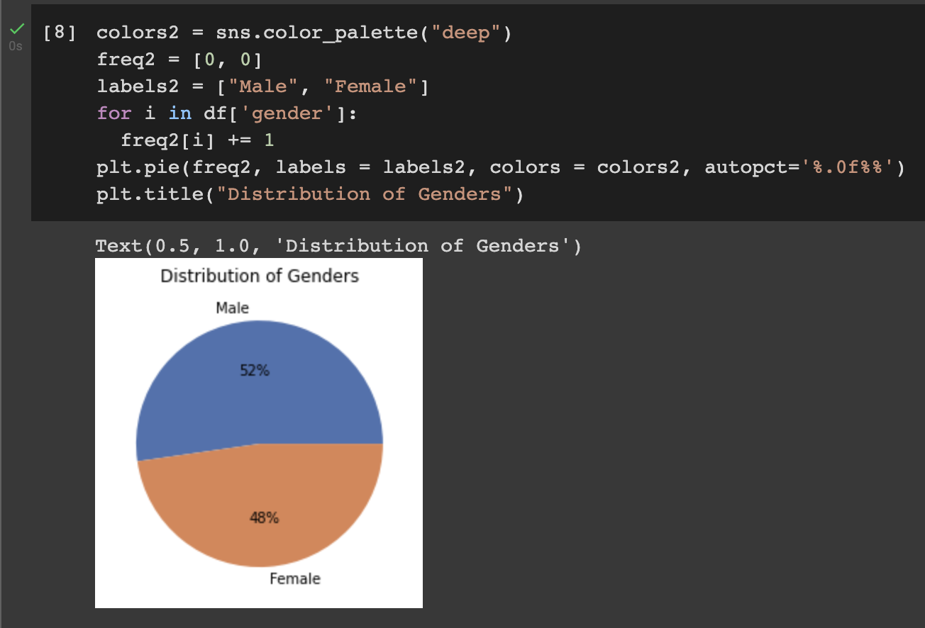
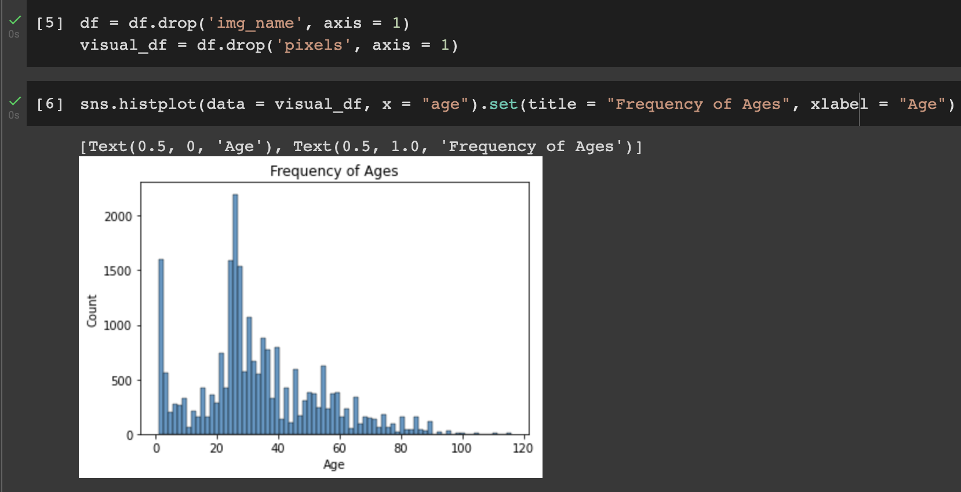
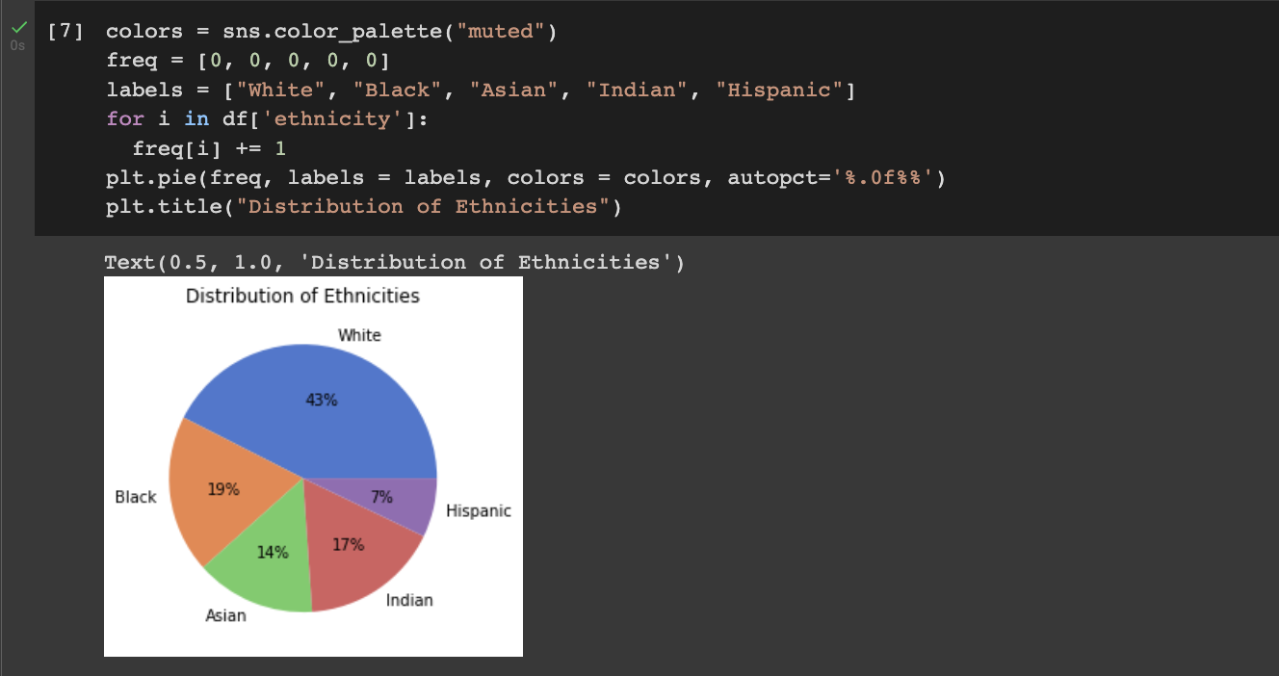
Feature Variables
Notes:
Andrew
Mention:
We wanted to analyze our core feature variables, so we decided to first drop the “image name” column since it’s useless, and pixels. Although pixels is necessary later on in order to apply the actual machine learning model, we don’t need it right now since we’re only looking at age, gender, and ethnicity
We first plot a histogram representing the frequency of ages using Seaborn. Dataset is generally bimodal with modes around 0 and mid 20s.
We then first a pie chart to depict the distribution of genders, and we can notice that there are about as many males as females, although there is a slightly higher male percentage.
We finally create a pie chart to illustrate the distribution of ethnicities, where we can see that a great majority of the pictures of white individuals, followed by black, indian, asian, then hispanic.

Slide 7
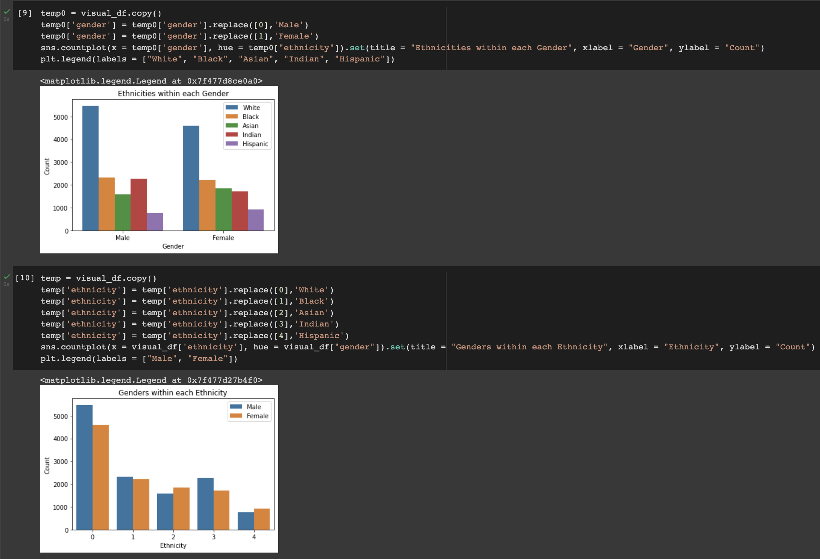
Relationships between
Feature Variables #1
Notes:
Silas
Mention:
We then moved on to compare feature variables with each other, just to ensure that the dataset is fair. For example, it would be pretty unfair if all pictures of individuals age 1 - 40 were female and 41+ male.
We first compared the feature variables gender and race with bar charts. Distributions seem pretty even
We then compared the feature variables gender and ethnicity with more bar charts. They all seem pretty even as well.

Slide 8
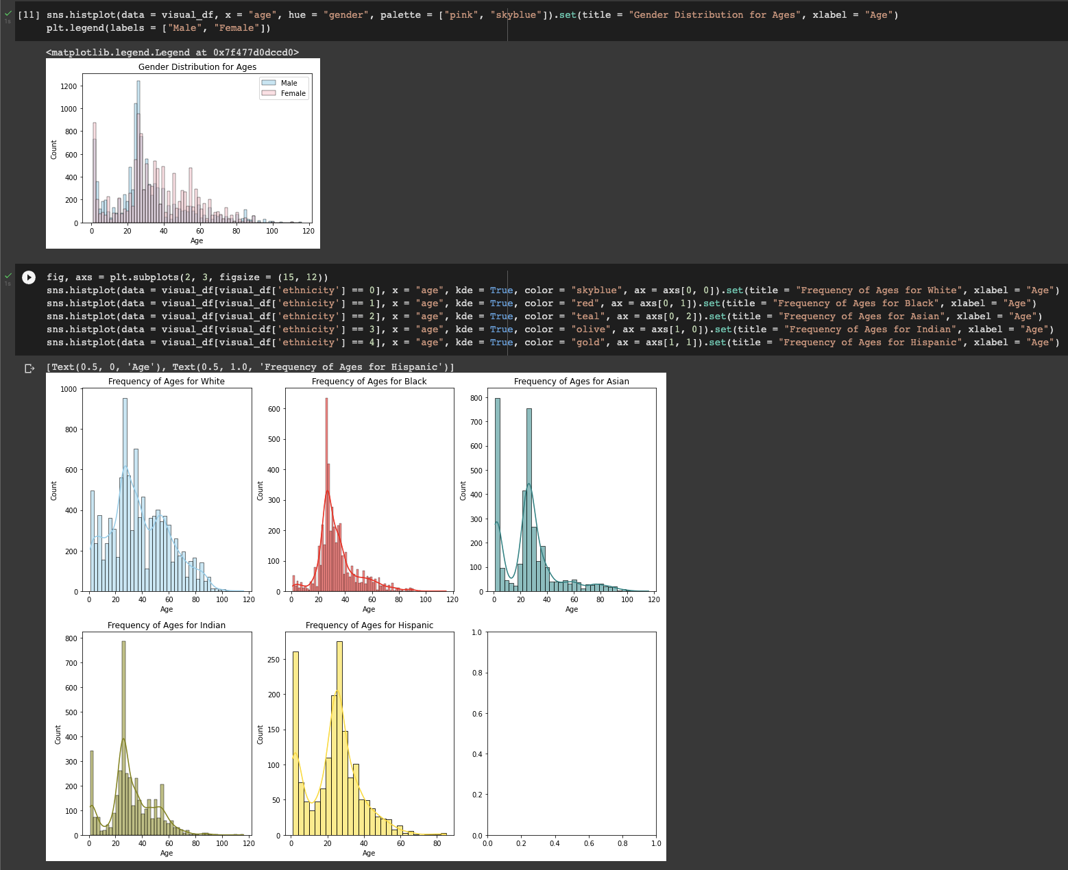
Relationships between
Feature Variables #2
Notes:
Daeyong
Mention:
We then compared the feature variables age and gender using overlapped histograms. They also seemed fairly even, although it’s important to note that there were more females in the first mode of age 0, but then more females towards ages 40+
We finally compared the feature variables ages and ethnicities. These distributions were the most skewed. The distribution for white individuals was relatively uniform and unimodal, the distribution for black individuals was clearly unimodal and not uniform, whereas the distributions for all other races were clearly bimodal and not uniform.
Overall, we can conclude that although this dataset is not perfect, it’s appropriate in terms of distributions and diversity.

Slide 9
Stage 2
Preprocessing Data
Notes:
Daeyong

Slide 10
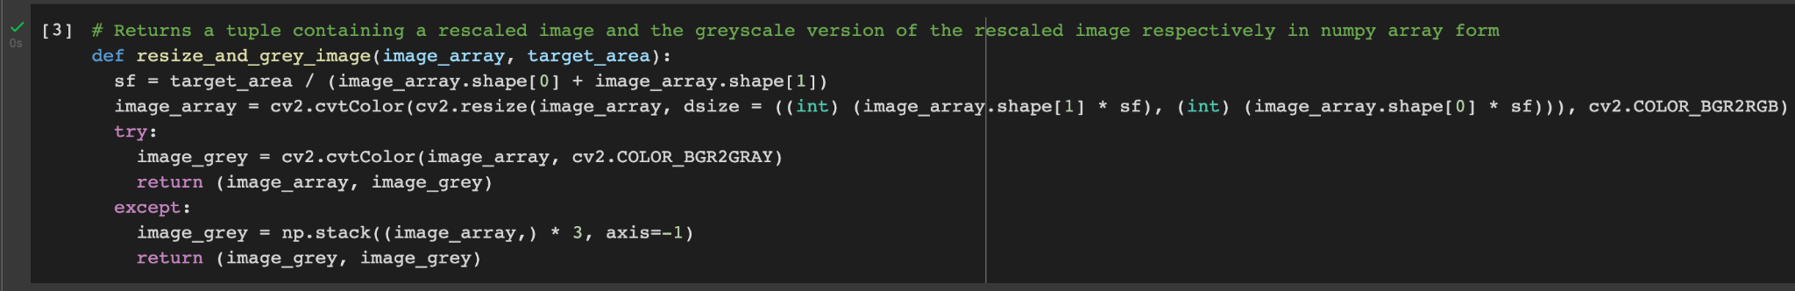
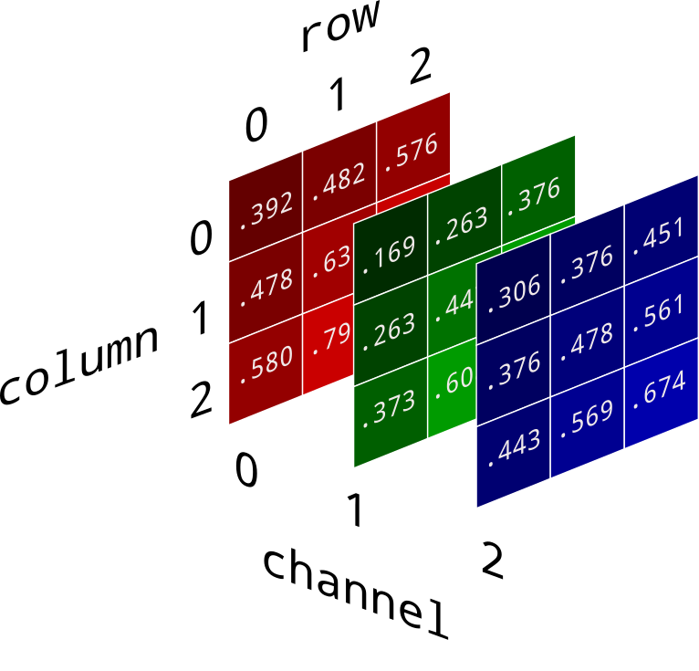
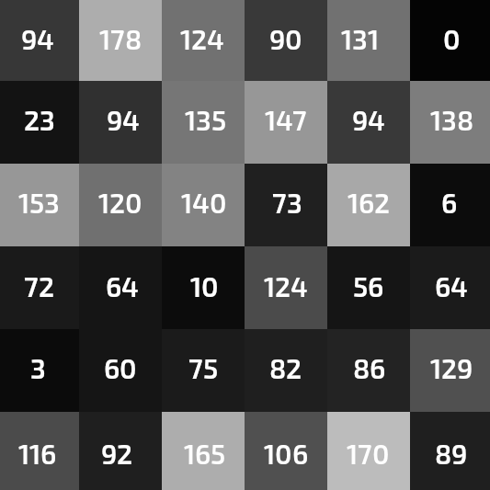
Resizing and Grayscaling Images
Notes:
Daeyong
Mention:
The pretrained model that we decided to work with accepted only grayscale matrices, so we had to design our own function that took any image, whether it be RGB or grayscale, and spit out an original copy for the resulting image (which we will see later) and a grayscale image for the model. We also wanted to be able to change the size of the image, so we calculated a scale factor based on the target image area and applied it to each dimension to result in the appropriate image size

Slide 11
Stage 3
Applying Models
Notes:
Daeyong

Slide 12
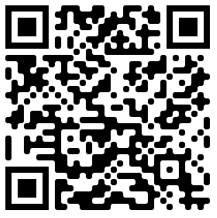
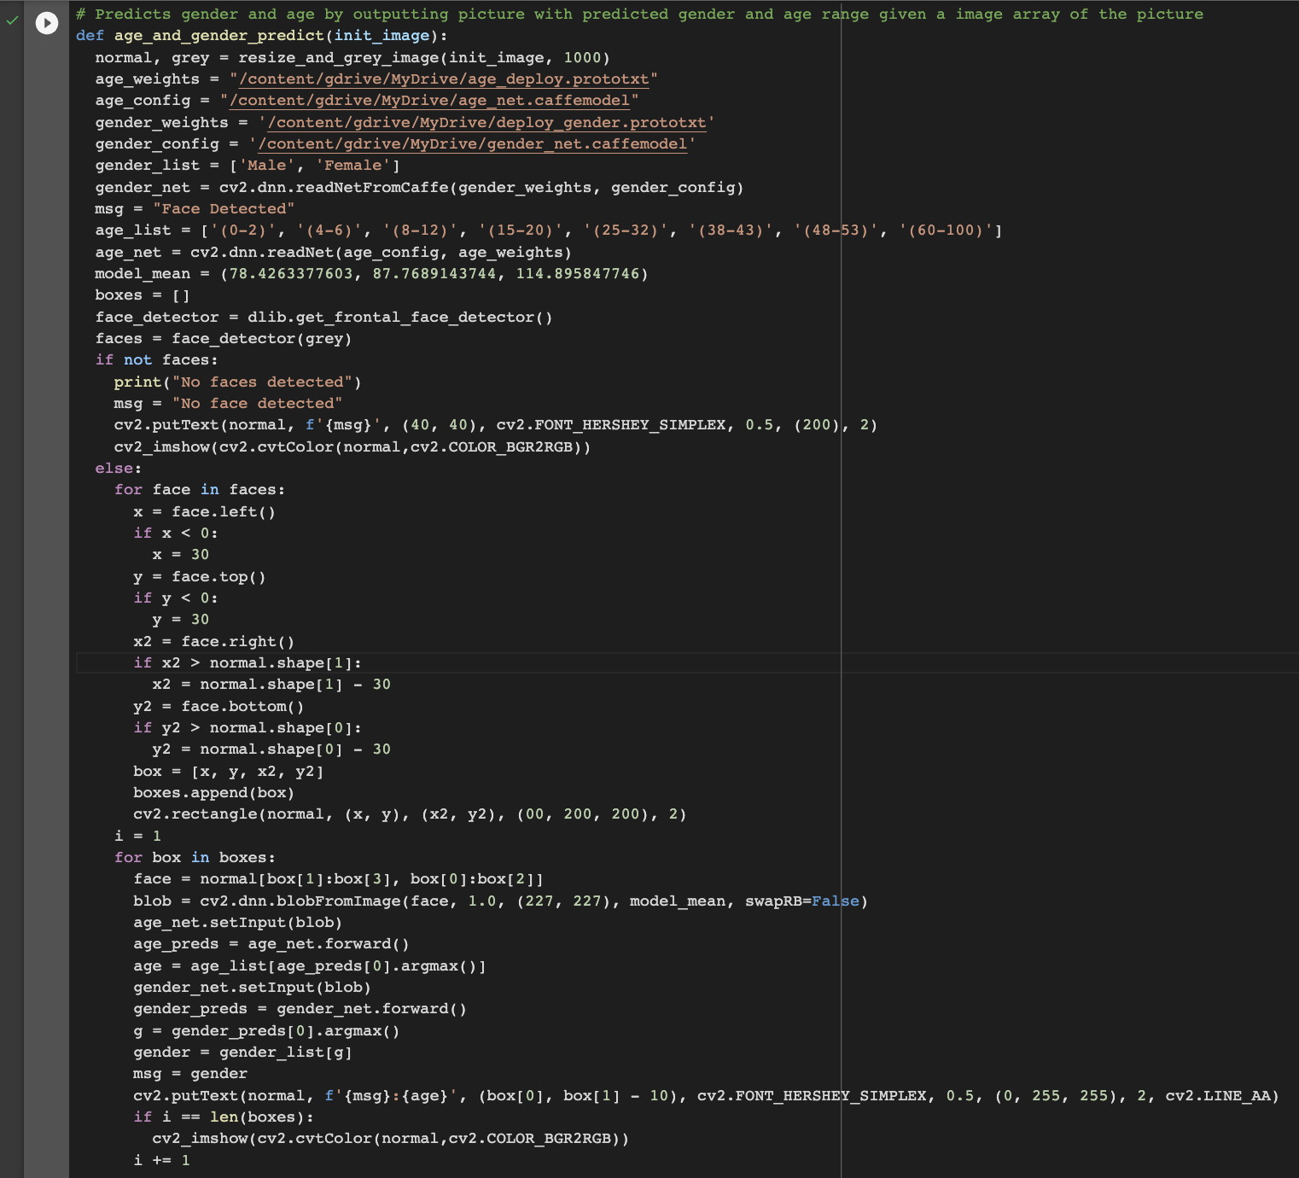
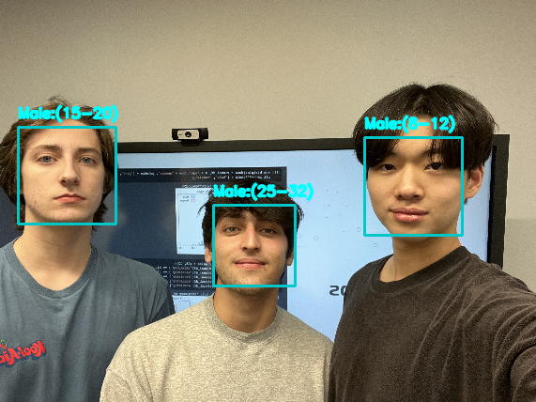
Predicting Age and Gender
Notes:
Daeyong + Silas
Mention:
Pretrained model is from a Geeks for Geeks article, source in QR code
Describe method that we used to identify faces and predict ages
First we used our resize_and_grey_image function
Imported the pretrained model through Google Drive and initialized some variables we’ll use later for labeling
Then we use the model to detect any faces, and if no faces are detected, we’ll just put that over the image. If there are faces that are detected, then for each face detected, the function draws a box around the face.
The function then uses each box to predict the age and gender of the face

Slide 13
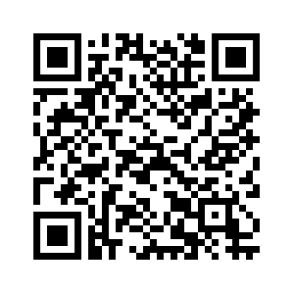
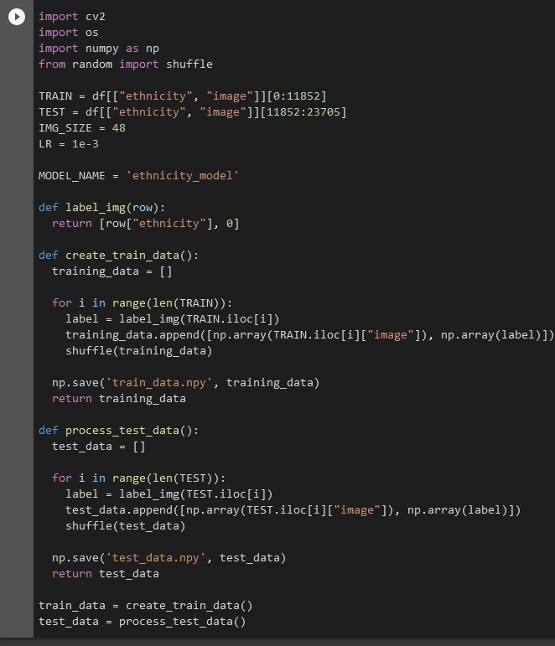
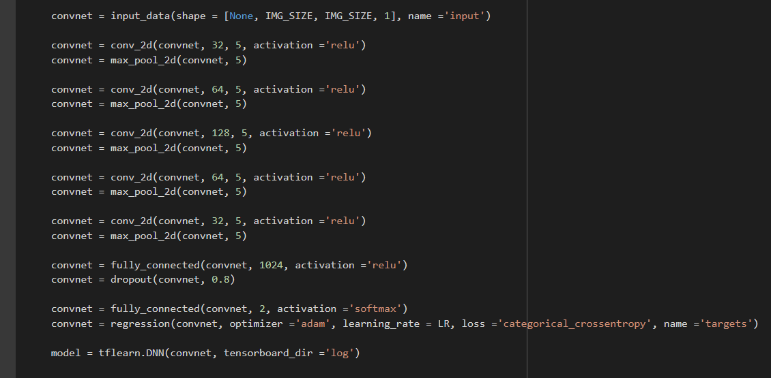
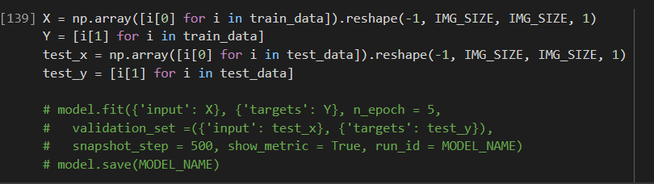
Creating the Model for Ethnicity Categorization
Notes:
Andrew:
Began by labelling each datapoint with its actual ethnicity and separating the data into training and testing data sets.
Then, began to construct the model using the tflearn tensorflow library. The geeks for geeks tutorial was especially helpful here in knowing which parameters.
Split the training and testing data sets into their image array values (X-axis) and ethnicity values (Y-axis). Then fit the data to the model and saved it to an external file.

Slide 14
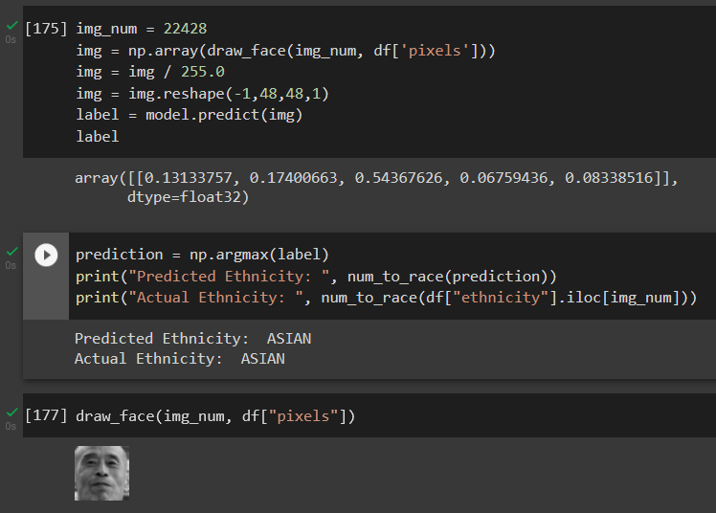
Predicting Ethnicity
Notes:
Andrew:
The model prediction is returned as an array of percentages, representing the likelihood of each ethnicity with the maximum percentage corresponding to the model’s prediction for their ethnicity.
Here, you can see that our model has correctly predicted that the person in this image is asian.

Slide 15
Stage 4
Reflections
Notes:
Andrew

Slide 16
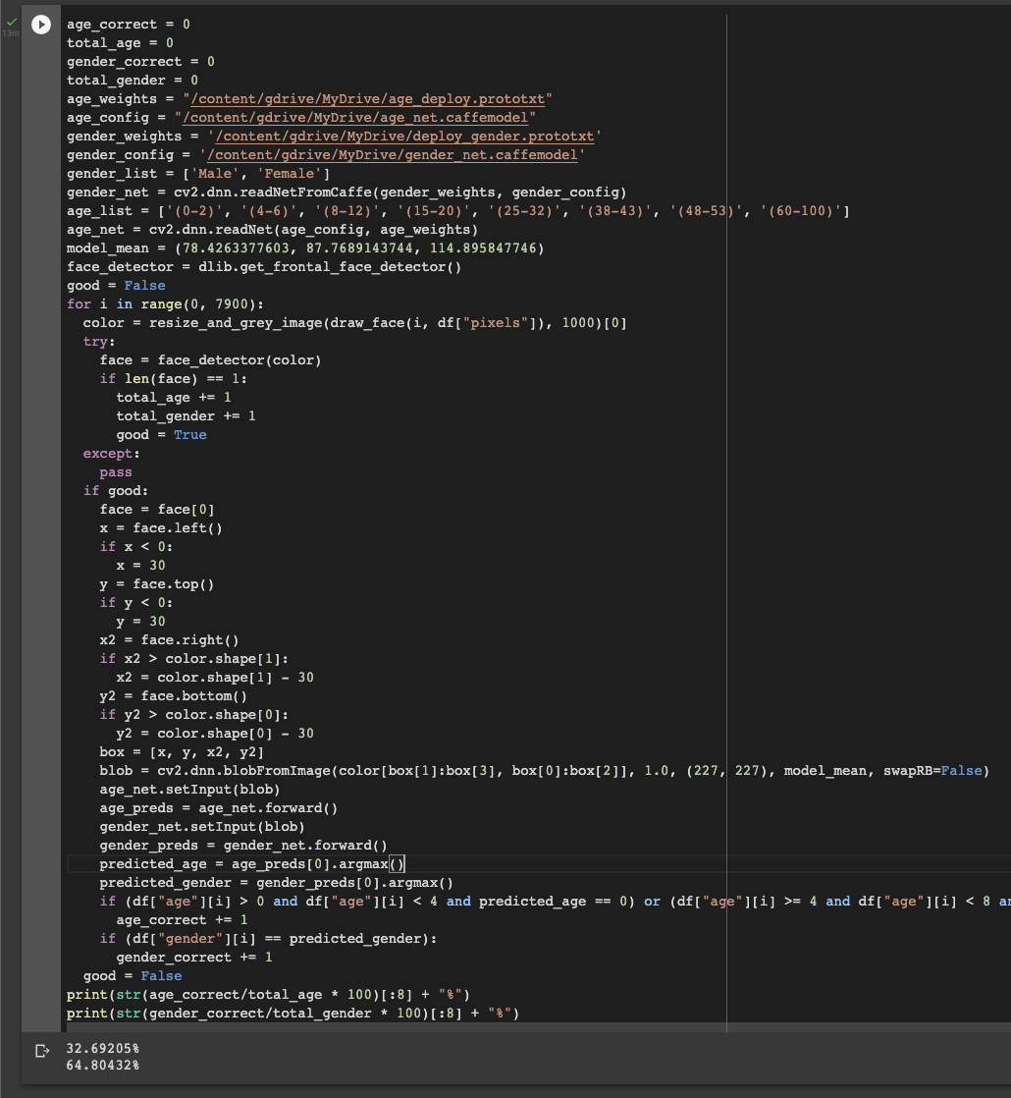
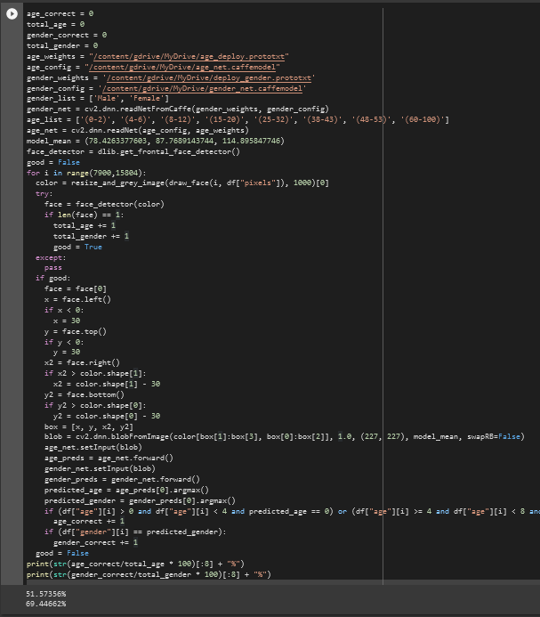
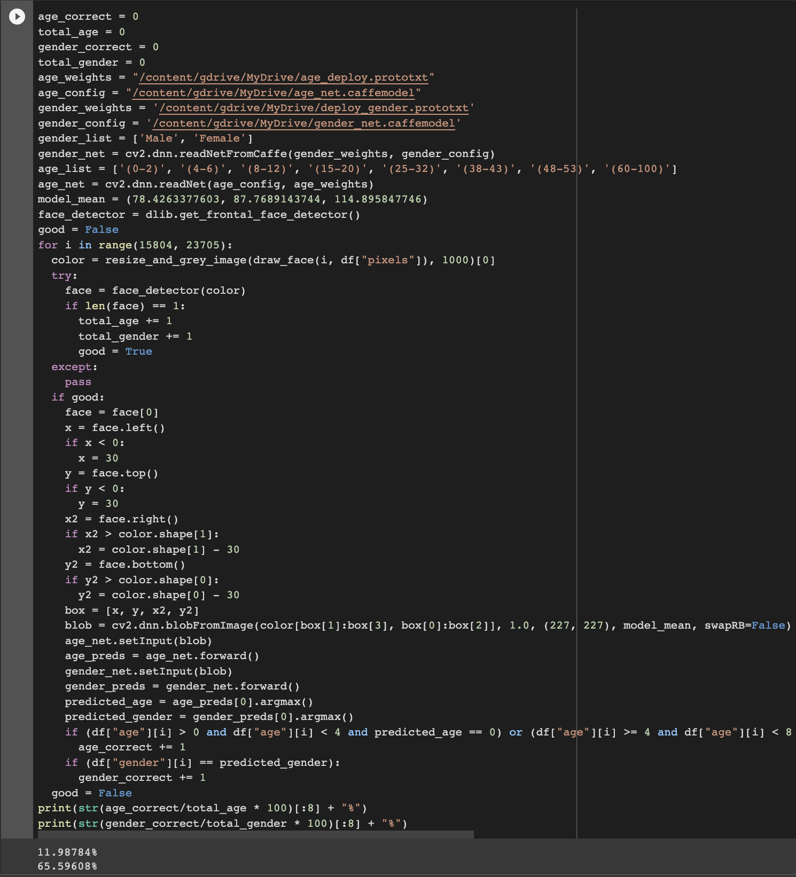
Testing Accuracy of the Model on our Dataset
0 - 7899
7900 - 15803
15804 - 23704
Notes:
Daeyong + Silas just talk

Slide 17
Statistics and Moving Forward
34.18%
66.62%
Accuracy of Age Detection on Dataset
Accuracy of Gender Detection on Dataset
Moving forward, we intend to test Ethnicity Detection and implement facial recognition for specific people. We also want to research into ways in which we can improve the accuracy of face-oriented machine learning models
Notes:
Andrew
Mention:
Accuracy of Age Detection
Accuracy of Gender Detection
Moving Forward comments

